Slide 2


Slide 3


Slide 4


Slide 5


Slide 6
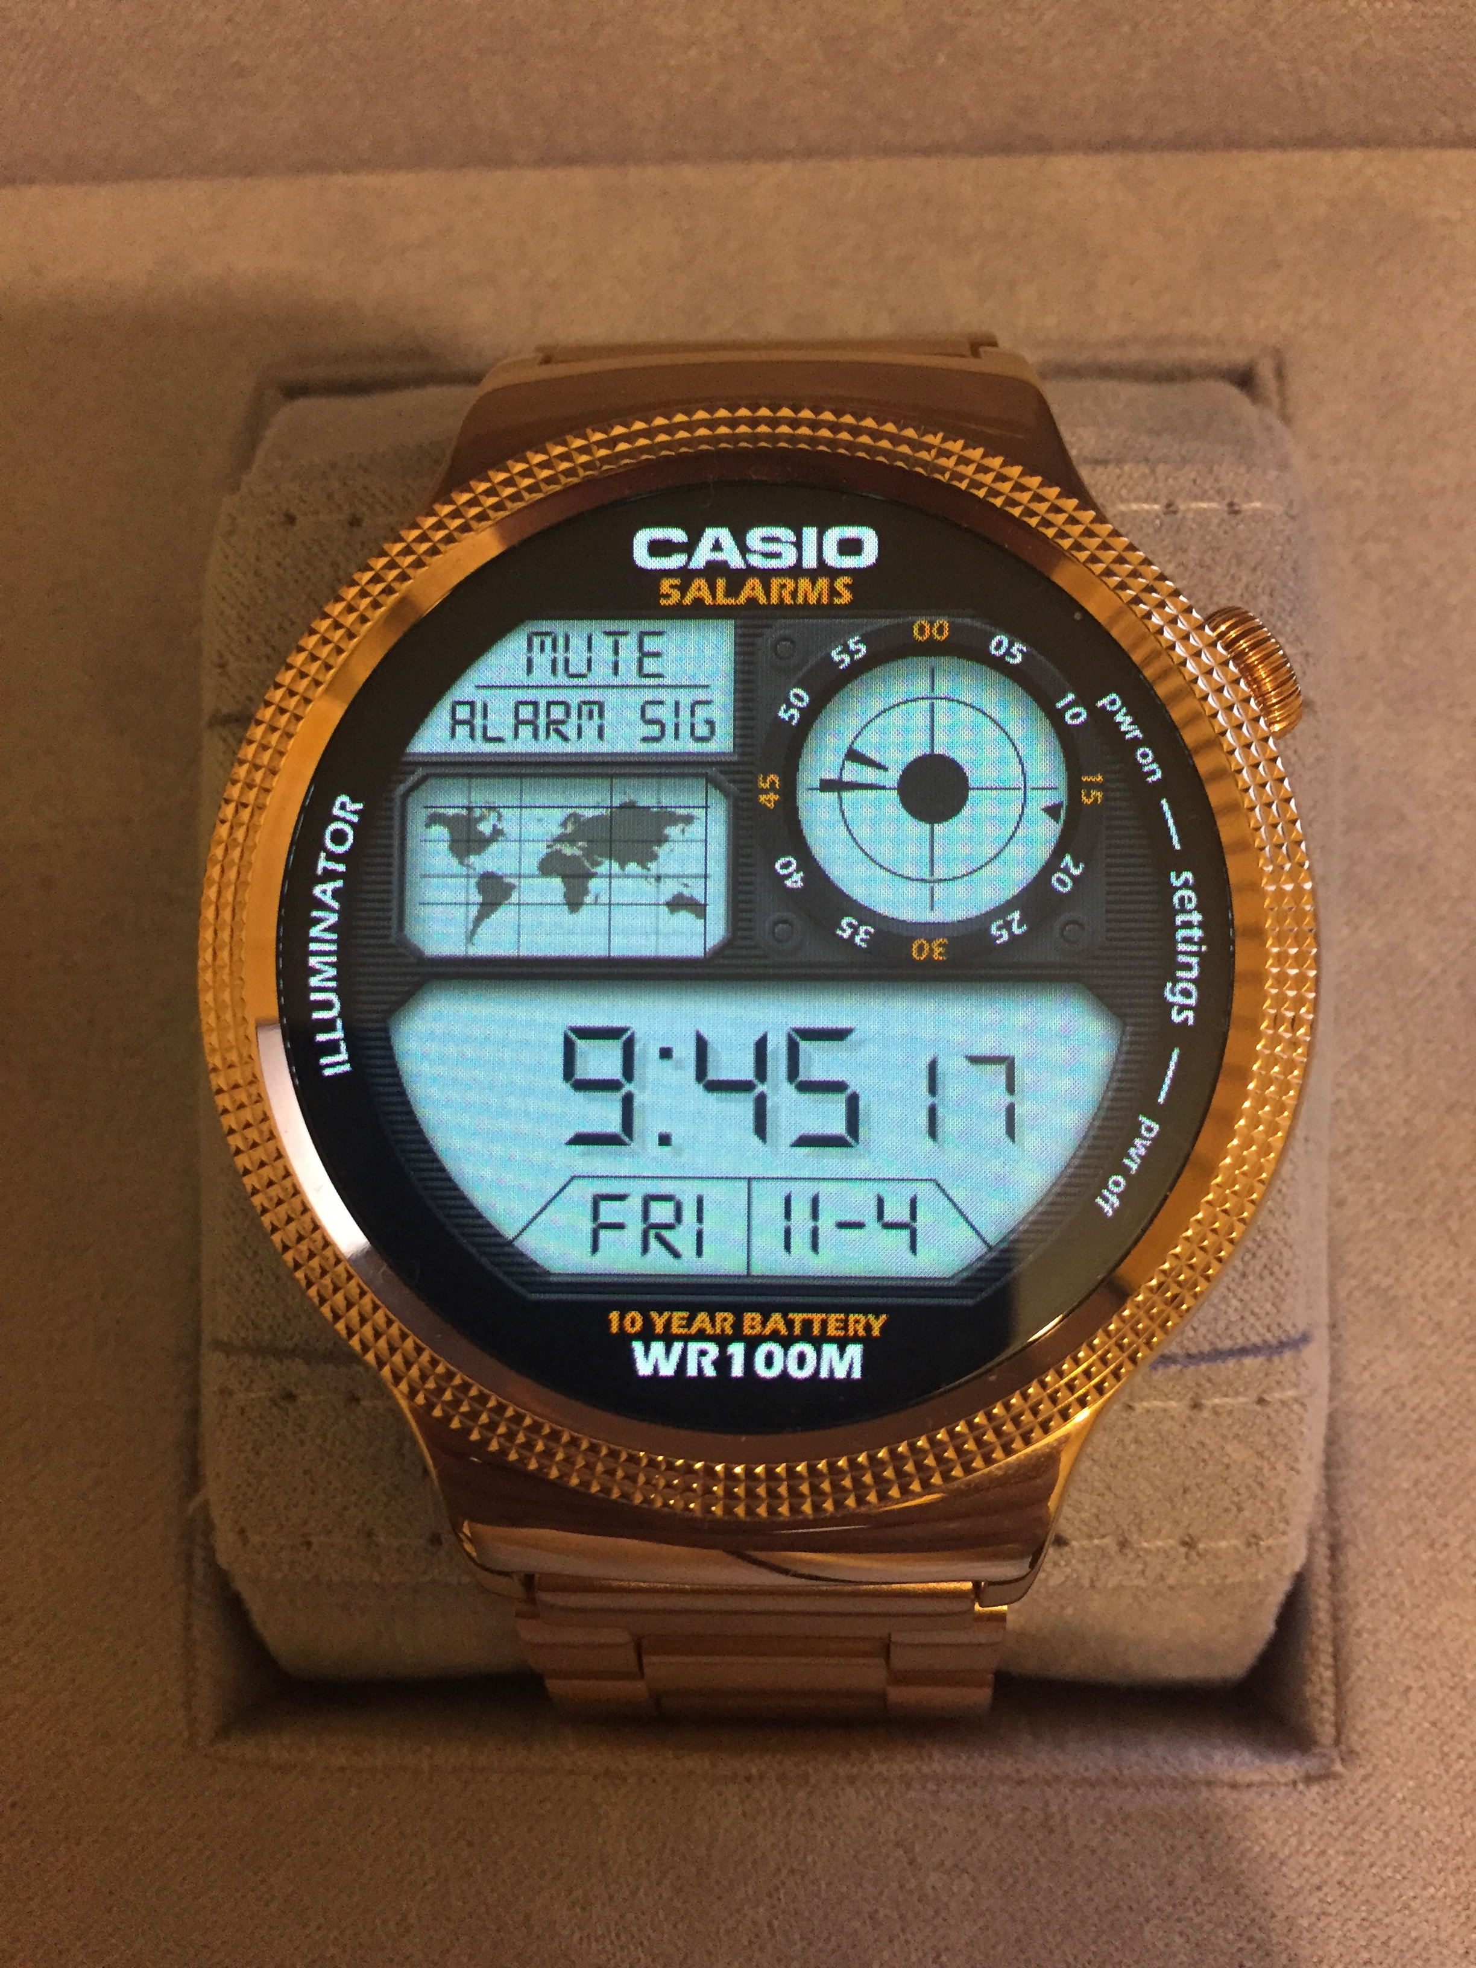

Slide 7


Slide 8


Slide 9


Slide 10
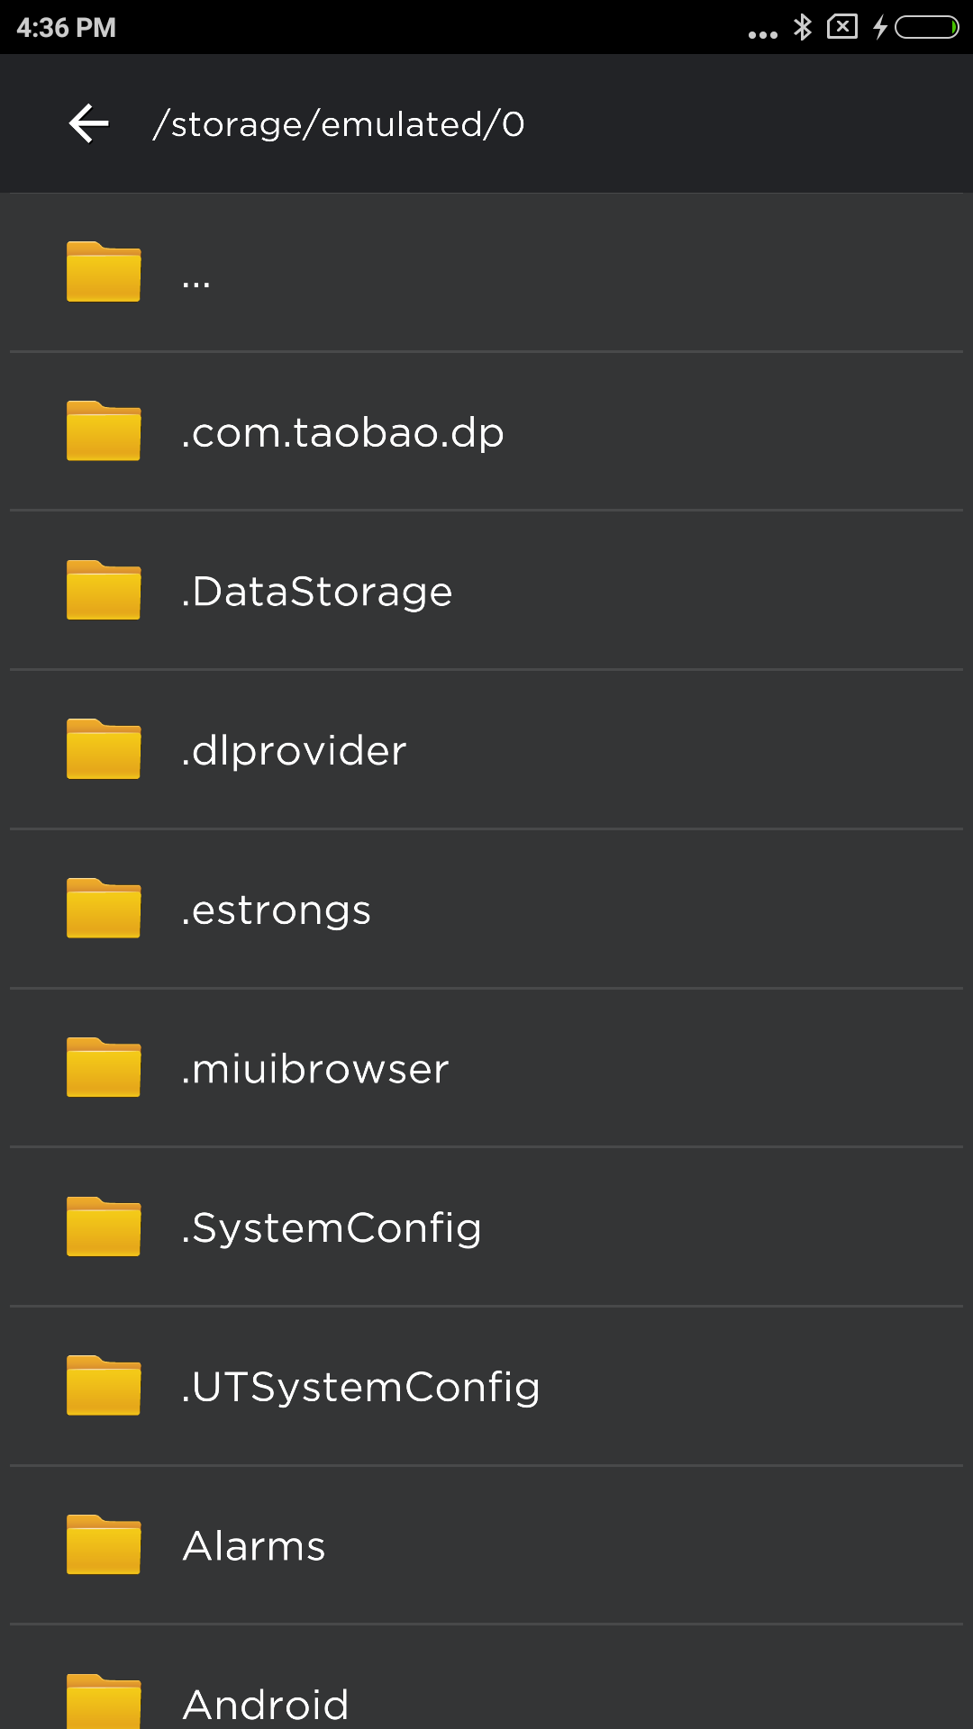

Slide 11


Slide 12
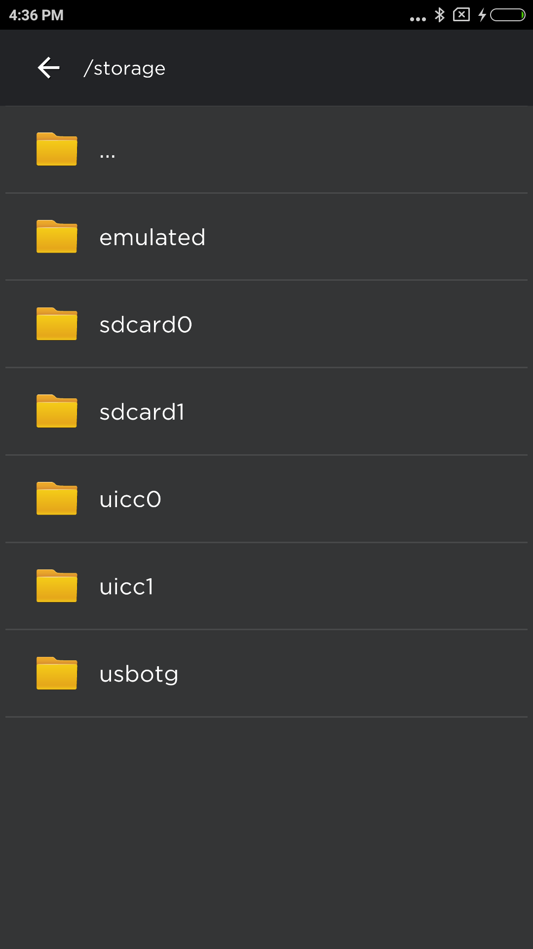

Slide 13
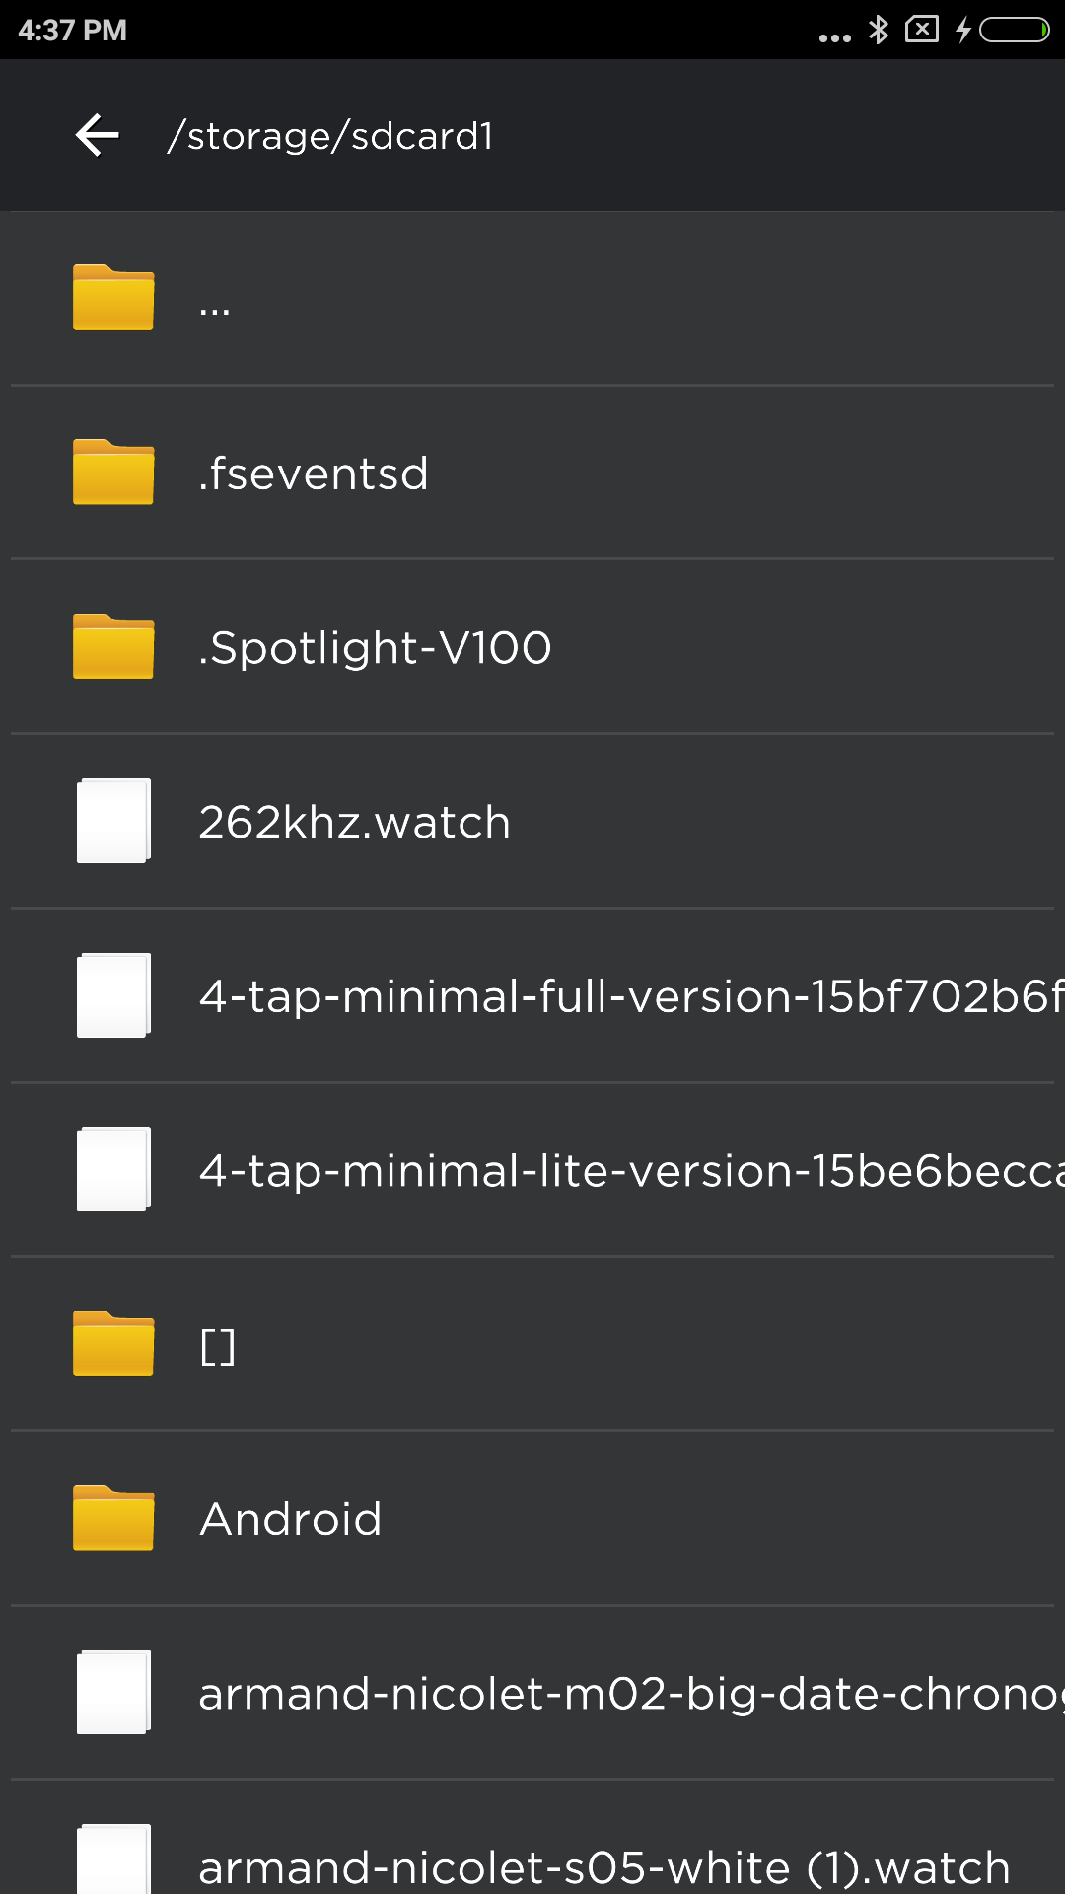

Slide 14
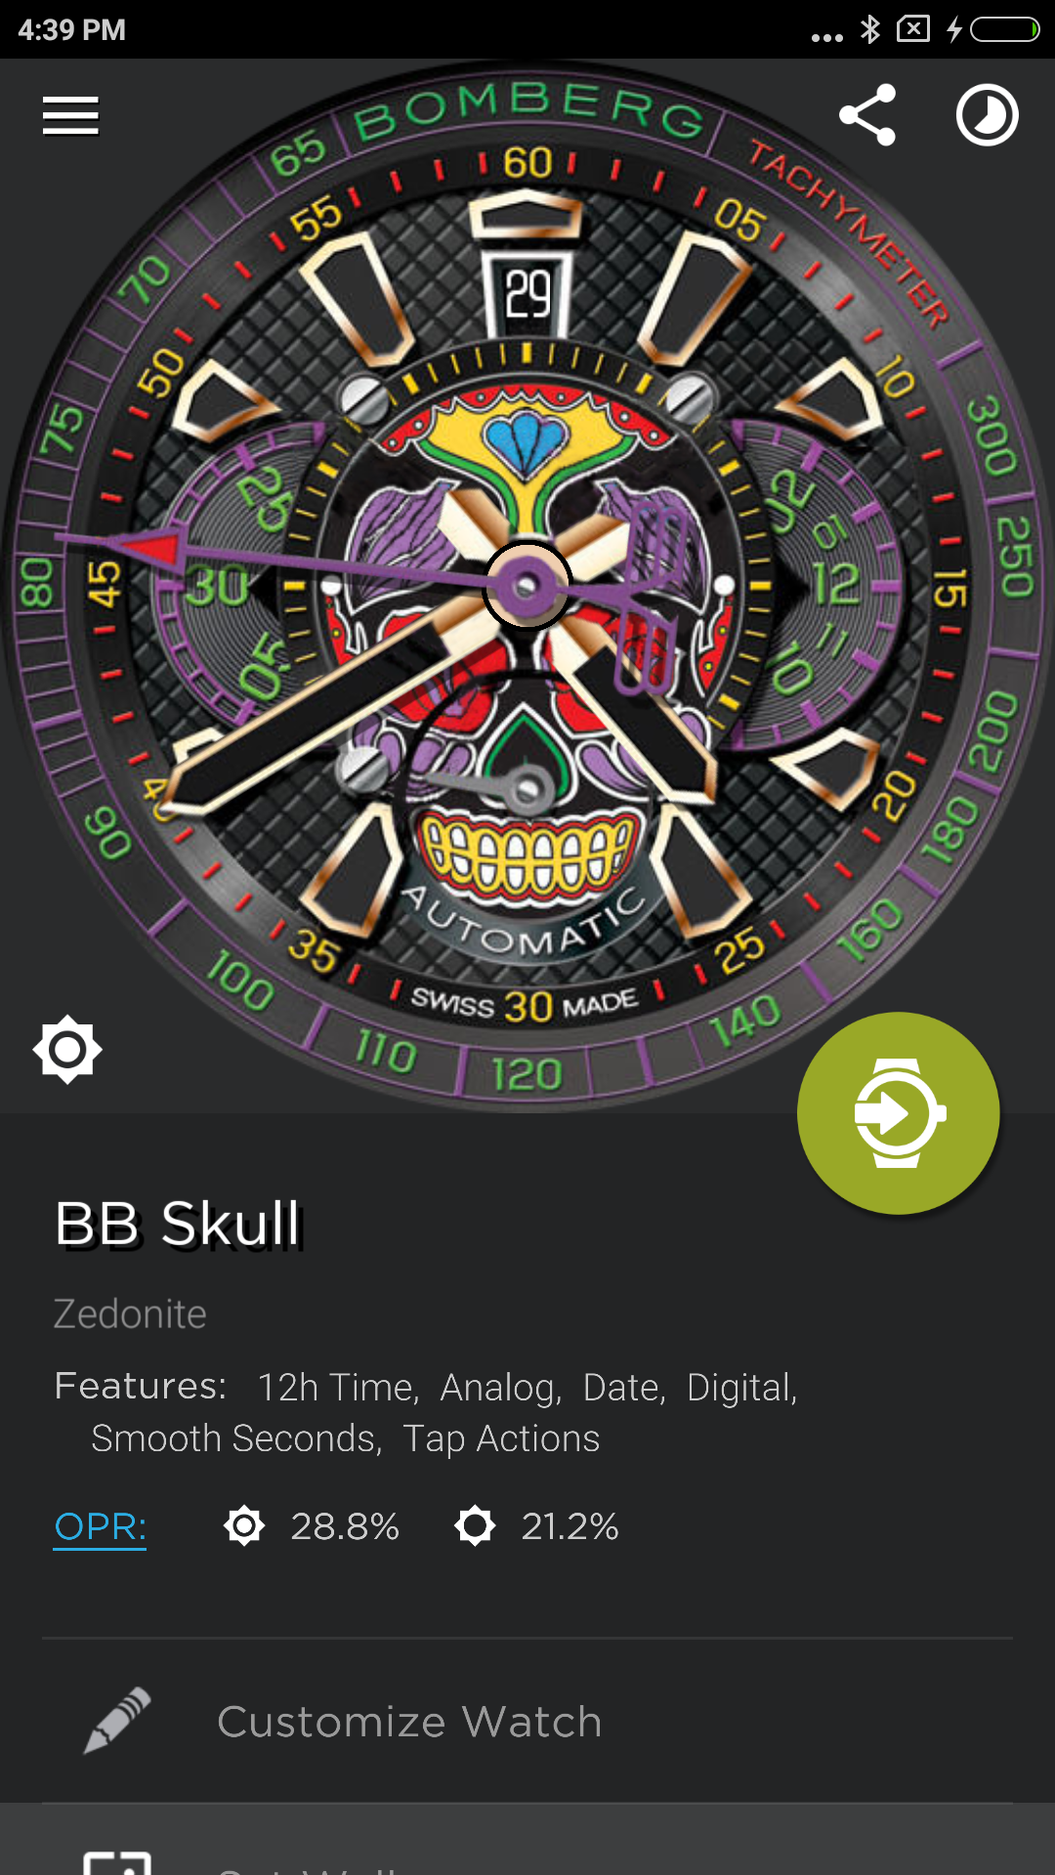

Slide 15
Things Learned:
Installed HomeBrew to install third-party software
Installed Pod to use pod files
how to clone an open source library and use pod to import it into my own code
xcworkspace vs xcodeproj
where the source library and document folders are
how to zip/unzip within Swift

